Slide 1

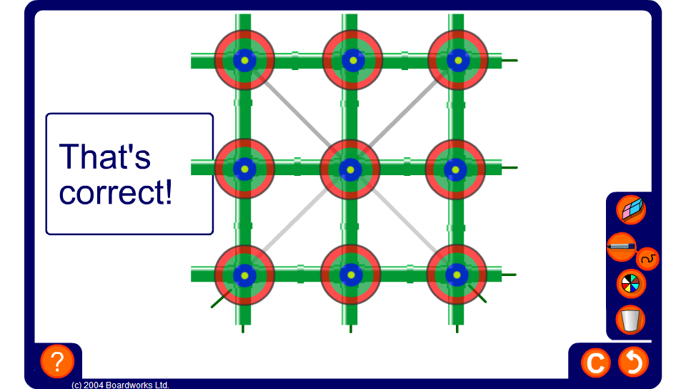


Fraction Puzzle
Notes:
Ask pupils how they can solve the puzzle on the board so that each row, column and diagonal has the same sum. Suggest that pupils convert all the fractions shown so that they have a common denominator.
Each puzzle is based on the whole number magic square:
4 9 2
3 5 7
8 1 6
Clicking on the check button will reveal the sum of each completed row column and diagonal.

